Slide 1
Health Information Network
Storyboard

Slide 2

Storyboard 1: Account Management
Scene 1: User Registration
User Action: The user clicks "Register" and fills in their details (name, email, password, role: patient/provider/regulator).
System Response: The system validates the data and creates the account.

Slide 3
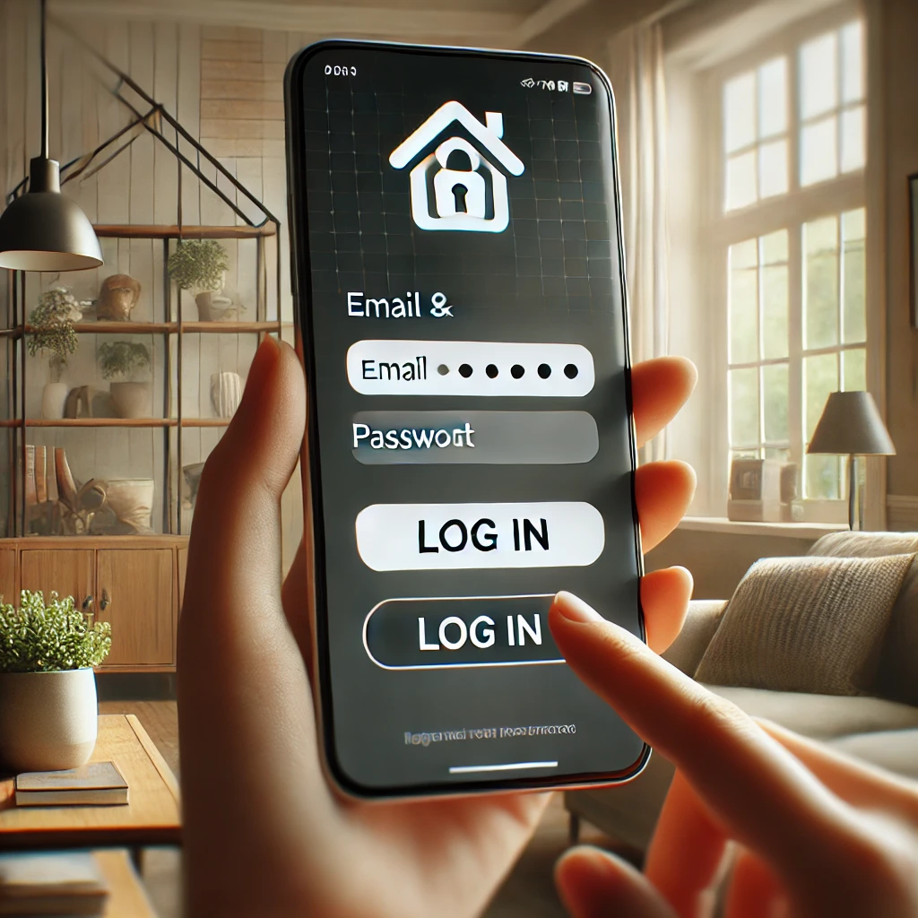
Scene 2: Login
User Action: The user enters their credentials and clicks “Login.”
System Response: The system authenticates the credentials and redirects the user to their dashboard.

Slide 4
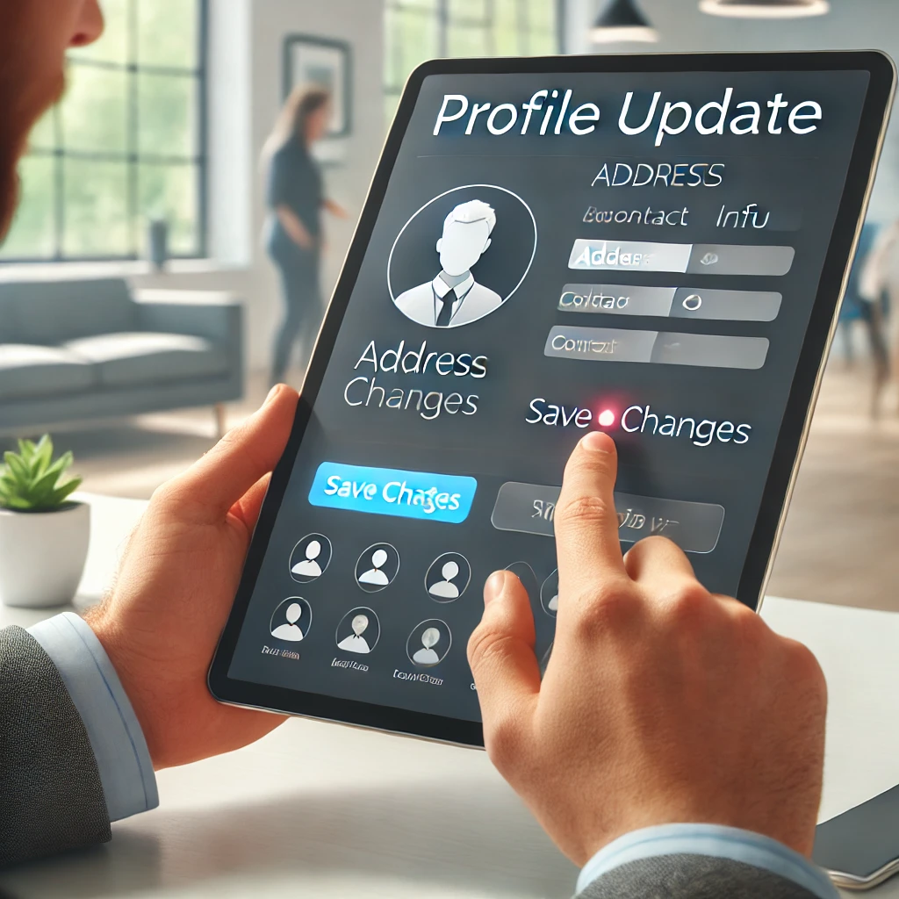
Scene 3: Update Profile
User Action: The user navigates to the "Profile" section and updates details (e.g., address, contact info).
System Response: The system validates and saves the updated information.

Slide 5

Scene 4: Logout
User Action: The user clicks the "Log Out" button.
System Response: The system securely ends the session.

Slide 6
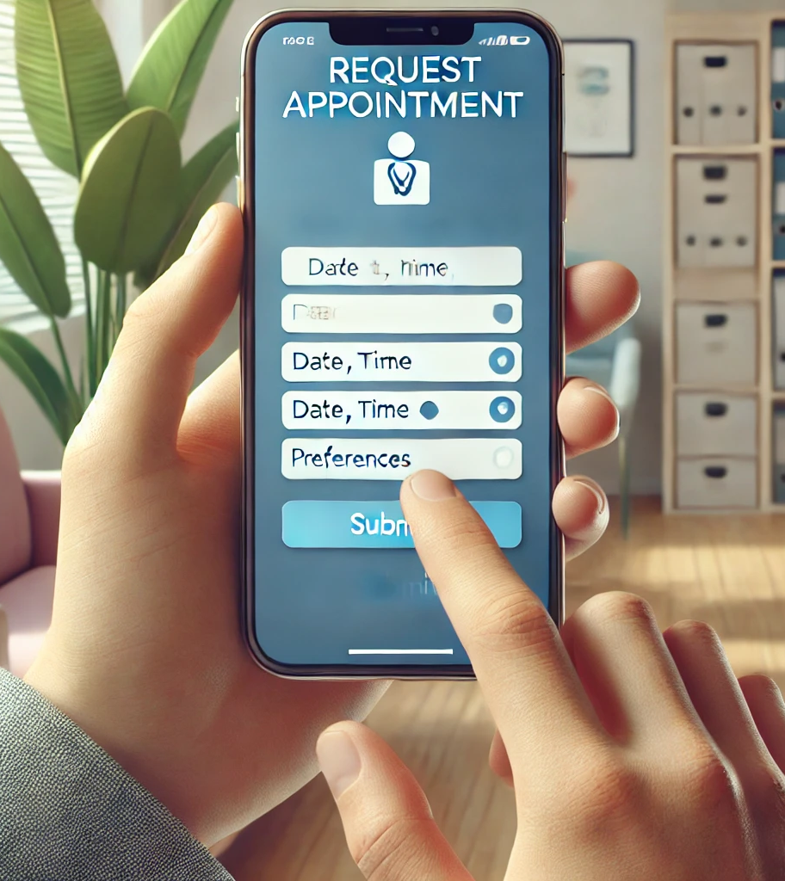
Storyboard 2: Appointment Management
Scene 1: Request Appointment
User Action: The patient selects "Request Appointment" and fills out details like date, time, and preferences.
System Response: The system validates the data and displays a list of available providers.

Slide 7
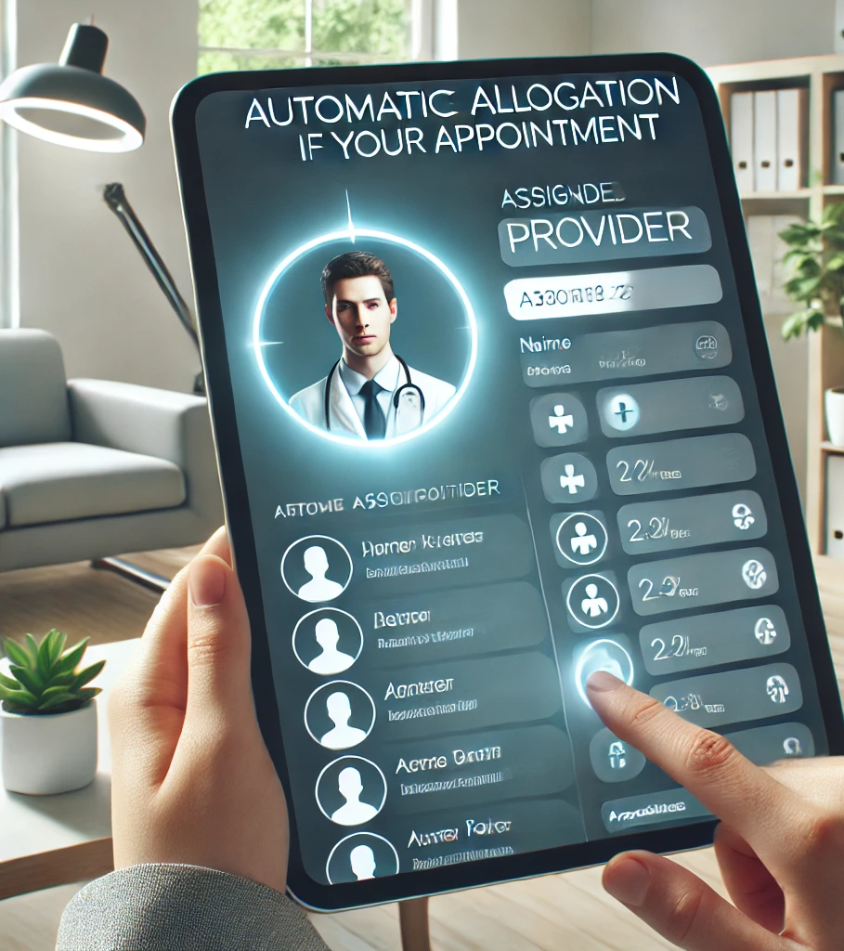
Scene 2: Allocate Provider
User Action: The system automatically allocates a provider based on availability and patient preferences.
System Response: The allocated provider is assigned to the appointment.

Slide 8
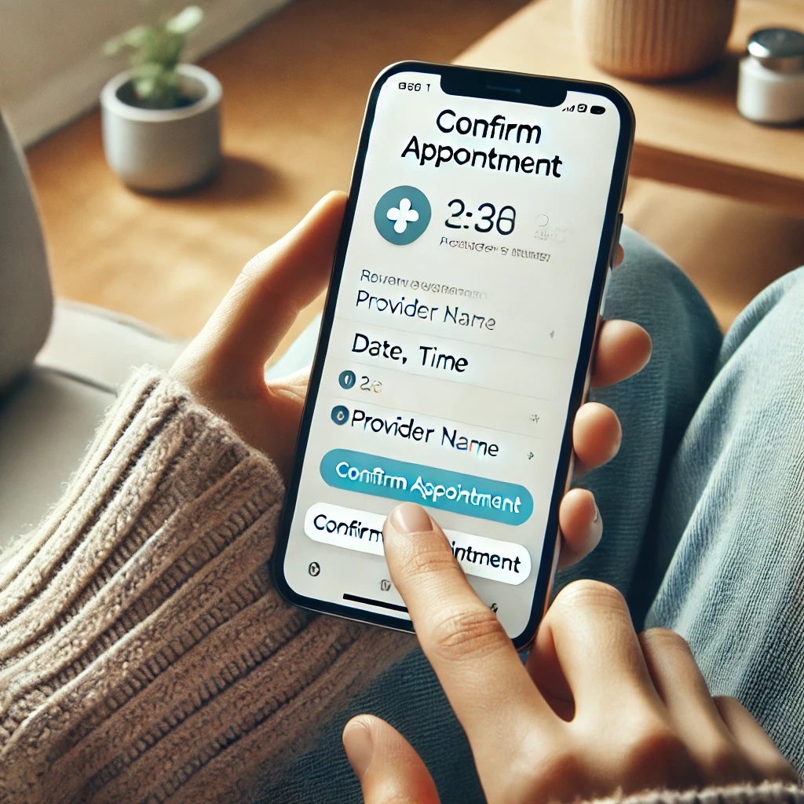
Scene 3: Confirm Appointment
User Action: The patient reviews the details and confirms the appointment.
System Response: The system finalizes the booking and stores it in the database.

Slide 9

Scene 4: Send Notification
User Action: No direct action (system task).
System Response: The system sends notifications to both the patient and provider with the appointment details.

Slide 10
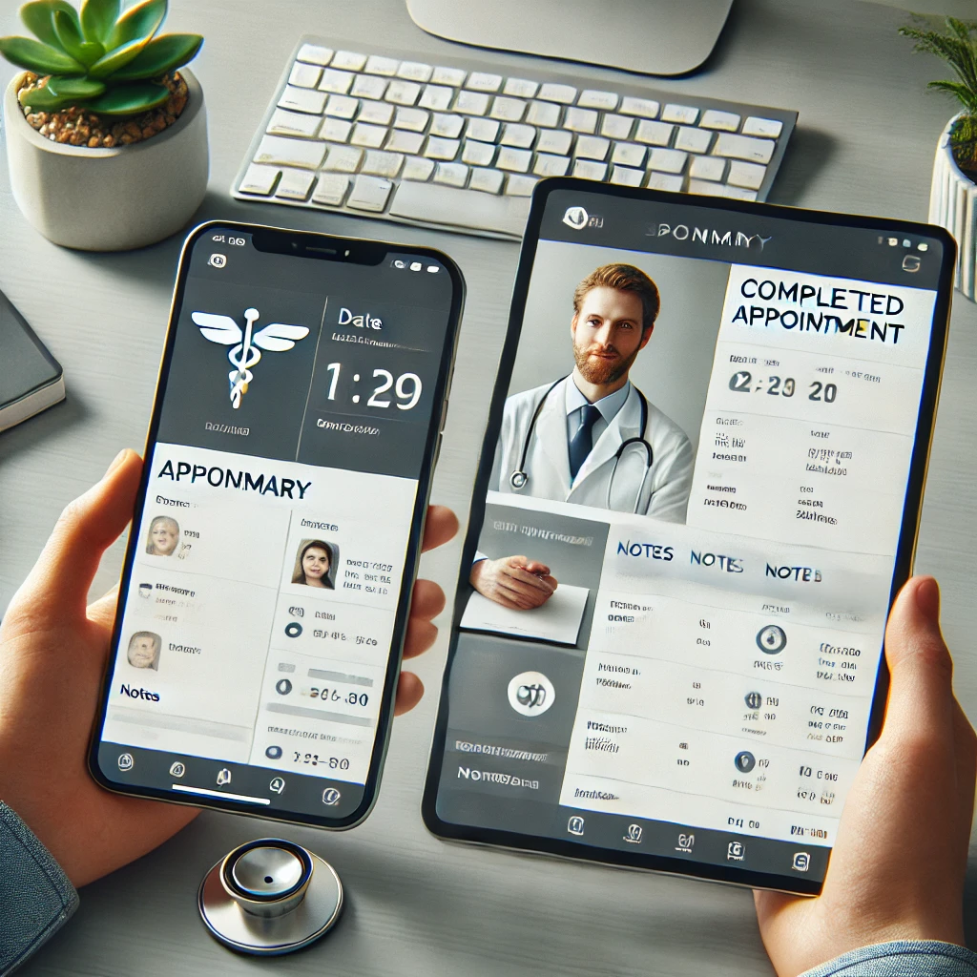
Scene 5: Appointment Completed
User Action: The patient and provider view the appointment details.
System Response: The system marks the process as complete.

